Slide 1
CEN 3078 Computer Security
Module 4 – Security Analytics

Slide 2
Security architectures
Moving target defense, Defense by pretense
Anomaly detection
Threat intelligence collection
Penetration testing
Risk assessment and management
Module-4: Security Analytics

Slide 3
Security architectures
Moving target defense, Defense by pretense
Anomaly detection
Threat intelligence collection
Penetration testing
Risk assessment and management
Module-4: Security Analytics

Slide 4








Critical Application Infrastructures
Consumer Apps
Online Retail
Health Care
Cloud Computing
And Networking
Advanced
Manufacturing
Gaming
Very large user bases, and web services that benefit societal needs

Slide 5
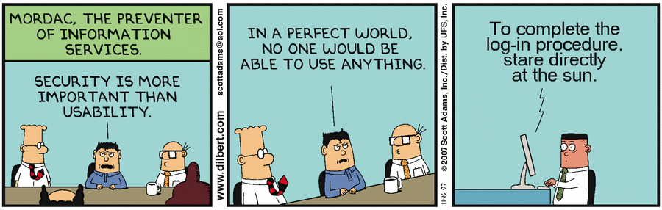
Balancing resilience (security) and user experience (performance/usability)
Security architectures need to build upon fundamental concepts of cyber security, along with their relevance in on-premise and cloud computing infrastructure for different application contexts…
Applications: Public Safety, Media, Manufacturing, Healthcare, SmartGrid, …
5

Slide 6
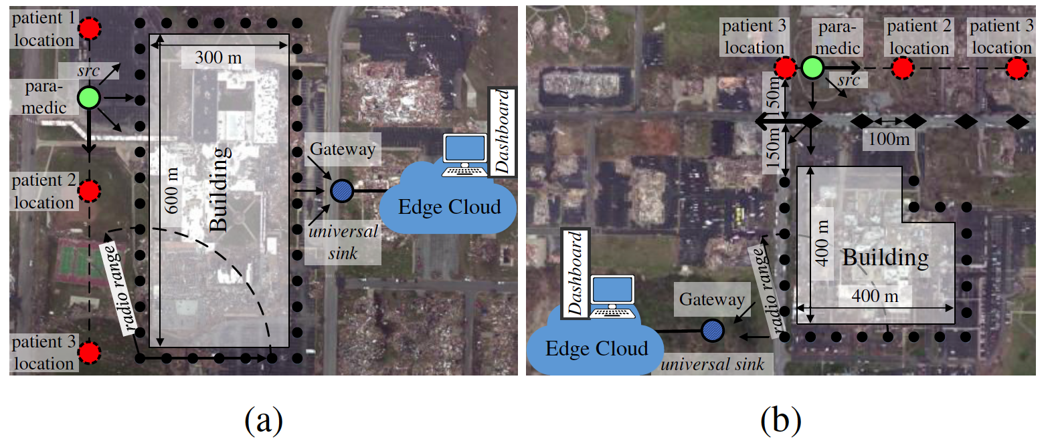
Lightweight and Flexible Security for IoT-based Public Safety Applications
Recreated disaster scenes of tornado damages (in Joplin, MO 2011) at the: (a) Joplin High School; (b) Joplin Hospital
6

Slide 7
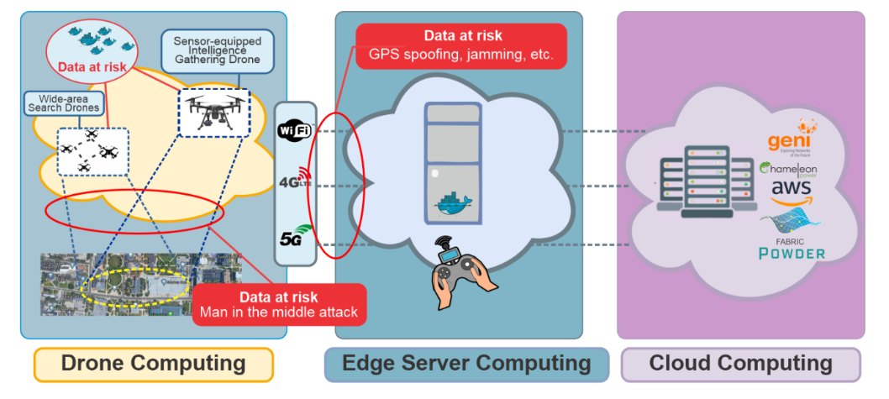
Lightweight and Flexible Security for IoT-based Public Safety Applications
IoT Gateway Middleware that uses machine learning to decide on tradeoffs in energy, latency and security in deciding computing policies at core or edge
A. Esquivel, D. Kavzak Ufuktepe, R. Ignatowicz, A. Riddle, C. Qu, P. Calyam, K. Palaniappan, “Enhancing Network-edge Connectivity and Computation Security in Drone Video Analytics”, IEEE Applied Imagery Pattern Recognition (AIPR) Workshop, 2020.
7

Slide 8
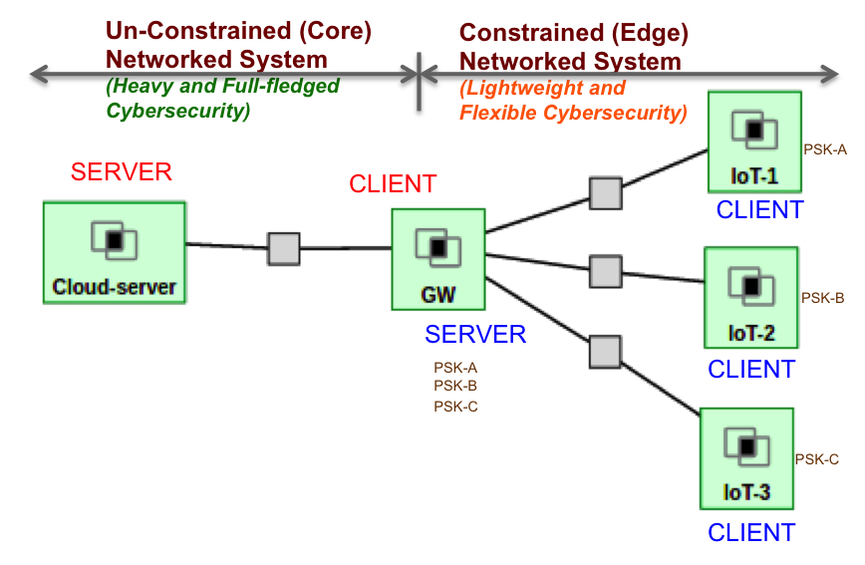
Lightweight and Flexible Security for IoT-based Public Safety Applications
IoT Gateway Middleware that uses machine learning to decide on tradeoffs in energy, latency and security in deciding computing policies at core or edge
8

Slide 9



Media Application: Just-in-time News Feeds
Recent shift in news related media consumption trends
Readers are relying on 'just-in-time news feeds' versus the traditional print medium
Media companies are offering ‘just-in-time news’ feed service for their subscribers who pay money for ‘premium’ content
Particularly popular in sectors such as Finance and Health Care
9

Slide 10
Media Application: Anomaly Detection
Used to detect anomalies occurring in a network path or server
Requires collection of profiles or signatures that represent the normal and abnormal behavior
E.g., number of failed login attempts permissible/occurred for a host, the level of processor usage, and consumed network bandwidth
Email threshold
Bandwidth threshold
Audit Data
Learning engine
Login fail
threshold
CPU usage
threshold
Training period
Profile
alarm
Activity data
Detect engine
pass
Detecting period
10

Slide 11
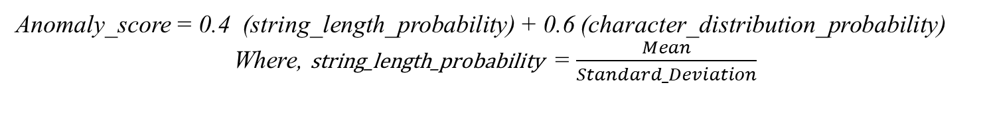
Media Application: Anomaly Detection
“URL Anomaly Detection” checks the abnormality of a URL through detection of the deviation of the character distribution in the received URL string
Training Phase:
Here, the data is trained using some sample URLs
From the URLs, an ASCII map count of each character is generated. This count is used in the Anomaly Detection phase to calculate the String Length Probability and Character Distribution Frequency Probability
Detection Phase:
This phase calculates the Anomaly value for a given input URL
The Character Frequency Distribution uses Histogram model to calculate the Frequency Distribution of each character in the given input URL string
The Anomaly Score is calculated as -
Anomaly_score = 0.4 (string_length_probability) + 0.6 (character_distribution_probability)
Where, string_length_probability = $\frac{Mean}{Standard_Deviation}$
11

Slide 12
Manufacturing Application Security & Privacy
“Agile manufacturing” builds on the benefits of cloud computing (e.g., businesses
Don’t need to invest and manage expensive computing resources or computational solver licenses)
Need to bridge the collaboration gap between Manufacturing App Developer and a Cloud Engineer in “Manufacturing App Marketplaces”
Or AWS, GCP, …
12

Slide 13
Manufacturing App Marketplace Security Architecture
How to secure on-going efforts to scale-up the App Marketplace with user opt-in via a new web-access layer features?
(a) an integrated single sign-on authentication
(b) on-demand/secure access to run virtual desktops, and virtual machines for web servers to host the various Apps
(c) secure storage of results after the computation stages to protect intellectual property of the manufacturers’ App designs and data sets
(d) Defense against LoC using HoneyFiles (Defense by Pretense)
13

Slide 14
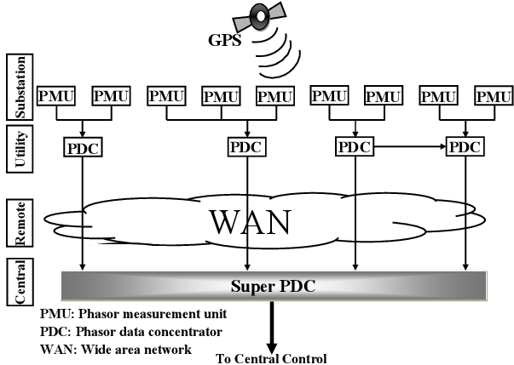
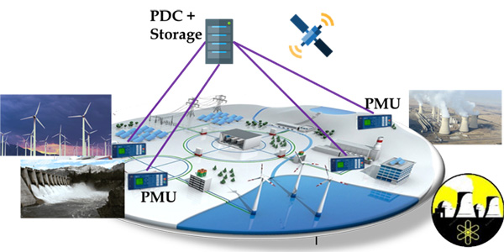
SmartGrid Application
Wide-area measurement and control systems (WAMCS) technology using Phasor Measurement Units (PMUs) is important
Helps guarantee resilience, stability, reliability, state estimation, control, and protection of next-generation power systems
However, there is an exponentially increasing number of PMUs and PDCs being deployed in the North American grid
Result is an explosion in data volume, which needs an efficient wide-area communication and computing infrastructure
14

Slide 15
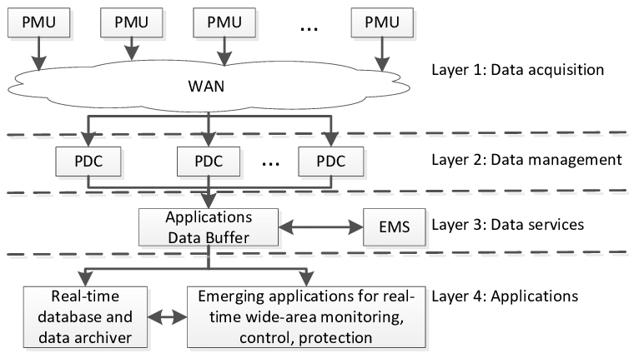
SmartGrid Application
As an example for power grids, according to UCAlug Open Smart Grid, every PMU (from a utility company) requires 600 to 1500 Kbps bandwidth, 20 ms to 200 ms latency, almost 100% reliability, and a 24-hour backup
WAMCS will require cloud computing resources (e.g., storage) and Gigabit per second bandwidth for satisfactory performance and resilience
Challenges are even more aggravated by the gradual transition from centralized to distributed systems for increased speed of data processing
With SDN
Privacy and Non-disclosure issues
15

Slide 16
SmartGrid Security Architecture
How to secure on-going efforts to store and process PMU data with utility companies opt-in via a new web-access layer and software-defined network features?
(a) an integrated single sign-on authentication
(b) on-demand/secure access to computation in the cloud to calculate e.g., secure state estimates in the power grids
(c) secure storage of results after the computation stages to protect intellectual property of the utility company’s data sets
(d) Defense against LoC attacks using Role-based Access Control
16

Slide 17
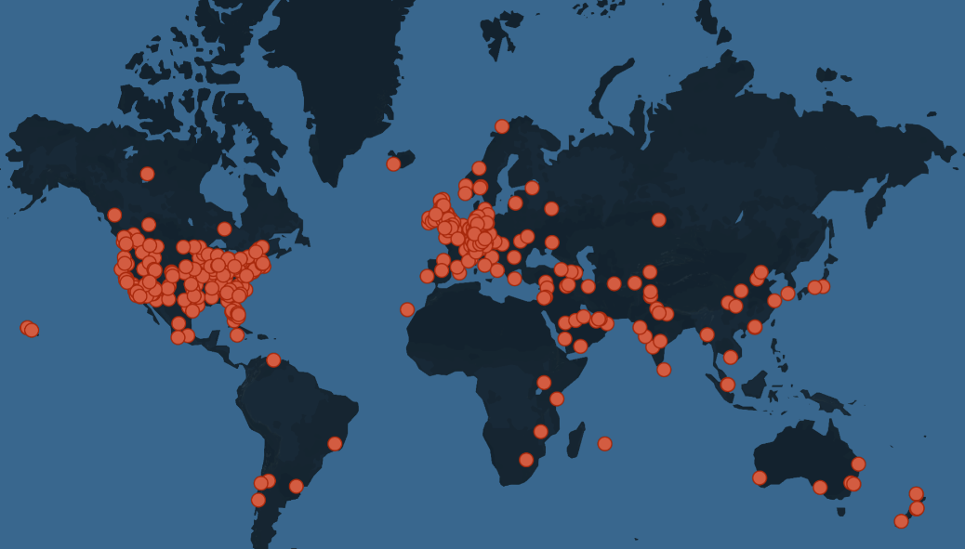
Drone Applications: Security Concerns
2015: A drone flew into the power line and causes 3 hours of black-out of several hundred houses in West Hollywood, near Los Angeles.
2016: Drone slam into Seattle's Space Needle.
2017: A drone fragment got caught in the front wheel of one of the cyclists, causing him to go over the handlebars.
2017: An accident that happened in 2017 in the Canadian province of Quebec, no eyewitnesses were present to prevent a drone collision. [3]
2019: Drone Crash into Las Vegas Stadium Causes $10K Damage
2021: Drone Slams into Building in World Trade Center
Fig. 1 Worldwide Drone Incidents, drone-related incidents and intrusions from around the world [2]
[2] https://www.dedrone.com/resources/incidents/all
[3] https://www.kaspersky.com/blog/drone-incidents/29000/

Slide 18
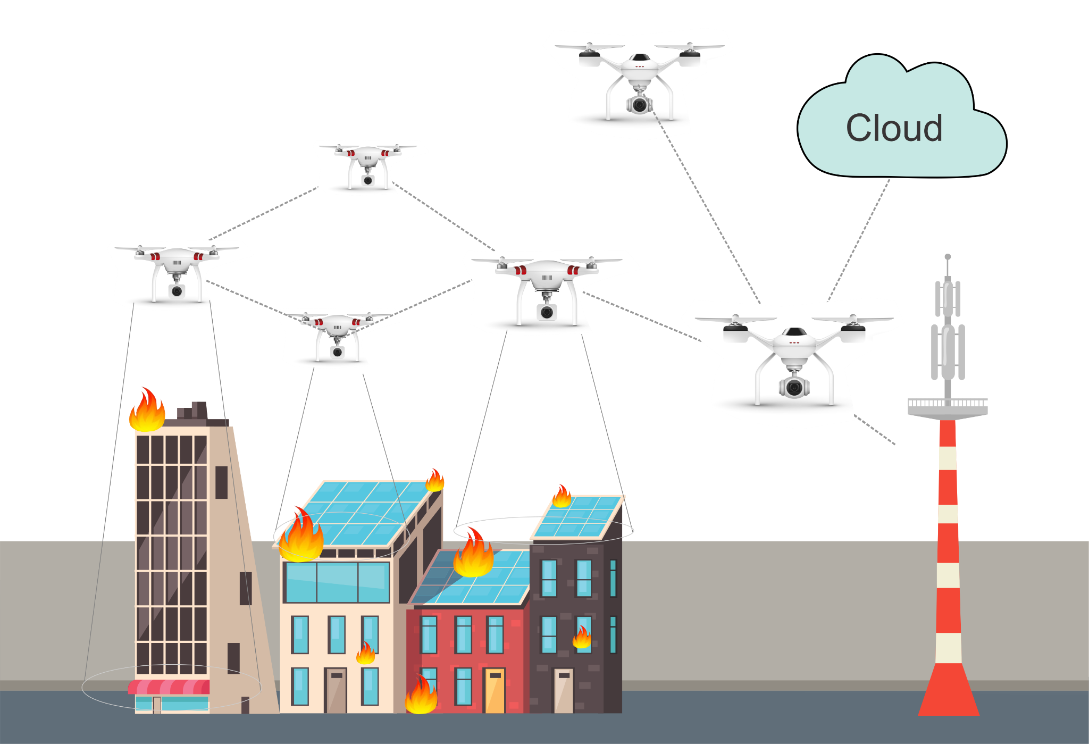
Drone Applications: Security Concerns
Drone swarms or collaborative drone systems with high-resolution video cameras are used for many operations such as precision agriculture, aerial imaging, and critical applications such as disaster scenarios or rescue response
Drone swarms can also provide and facilitate communication in areas where terrestrial infrastructure is poor or has been destroyed.
Drone swarms and their integration with cloud/edge infrastructure accomplishing collaborative missions.

Slide 19
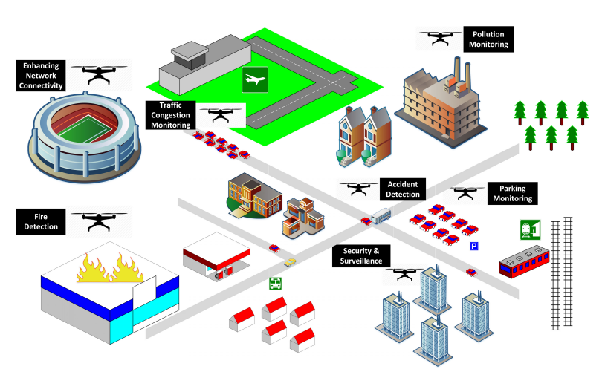
Motivation on Collaborative drone systems
Pollution
Monitoring
Collaborative drones and IoT play a vital role in supporting a lot of smart city applications such as those involved in communication, transportation, agriculture, safety and security, disaster mitigation, environmental protection, service delivery, energy saving, e-waste reduction, weather monitoring, healthcare, etc. [4]
Enhancing
Network Connectivity
Traffic
Control
Monitoring
Accident
Detection
Packing
Monitoring
Fire detection
Security
And
Surveillance
Fig. 3 Collaborative drone and IoT for improving the smartness of smart cities[7]
[4] Alsamhi, Saeed H., Ou Ma, Mohammad Samar Ansari, and Faris A. Almalki. "Survey on collaborative smart drones and internet of things for improving smartness of smart cities." Ieee Access 7 (2019).

Slide 20
Security and challenges in Collaborative Drone Systems
The use of these systems has been increasing and the issues related to security, privacy, reliability, regulation, and ownership are also increasing at the same pace [5].
Furthermore, collaborative drone systems are usually resource-constrained, in addition to being highly vulnerable to physical and cyber attacks/threats.
Challenges exist to secure the communication in collaborative drone services in terms of privacy leakage, data confidentiality protection, and the lack of development and implementation of mechanisms for reliable and secure protocols [6].
[5] Hassija, V., Chamola, V., Agrawal, A., Goyal, A., Luong, N.C., Niyato, D., Yu, F., & Guizani, M. (2021). Fast, Reliable, and Secure Drone Communication: A Comprehensive Survey.
[6] C. Lin, D. He, N. Kumar, K. R. Choo, A. Vinel, X. Huang, "Security and Privacy for the Internet of Drones: Challenges and Solutions", IEEE Communications Magazine, Vol. 56, no. 1, pp. 64-69, 2018.

Slide 21
Attacks on Drones
Attack Vectors
How these attacks are performed
DoS
Throughput is decreased. The communication between UAVs and the GCS is slowed and eventually, it will go out of service.
The attacker changes the GPS location information in the packets causing the target UAV to change its target destination (sending information to another agents, or making it crush to an entity)
MITM
Black Hole
This malicious node begins to beacon with the other UAVs in the swarm, and show high levels of energy, consistent on the protocol activity, causing the UAV to run out of energy before reaching the destination or accomplishing the task.

Slide 22
Zero Trust – One way to solve all
Modeling threats that focus on
Zero Trust - Defense Mechanisms
Check for a maliciously high data rate of packers from any UAVs in the network. If a drone is found to be send packets at a rate greater than the threshold, the node is blacklisted from the network and the updated blacklist will be sent to the remaining drones in the network.
Compares the energy levels of the drones in the network with a predetermined energy threshold based on the known energy capabilities of the UAV. If the energy level of a UAV is greater than the threshold, then the node is blacklisted from the network.
Apply message authentication by using a hash value for each packet and an algorithm to enforce policies if the message integrity is violated.
Detection
Prevention
Mitigation

Slide 23
Security architectures
Moving target defense, Defense by pretense
Anomaly detection
Threat intelligence collection
Penetration testing
Risk assessment and management
Module-4: Discussion Topics

